Slide 1

Business Incubation ’15 March
Incubation Program by CEED Tech

Slide 2





Budapest, Hungary
Prague, Czech Republic
Tallinn, Estonia
Vilnius, Lithuania
Bratislava, Slovakia

Slide 3
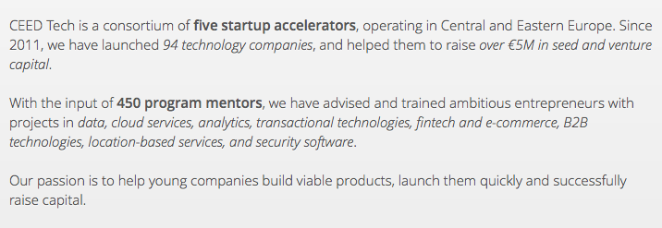

ABOUT CEED TECH

Slide 4
Program Details
3 months long program - 1 month follow-up
In-House Incubation – Budapest, Hungary
10k - 30k EUR seed funding (Co-Financed)
10% Equity
+
Potential 100k EUR follow up financing
International Program - English

Slide 5


Slide 6
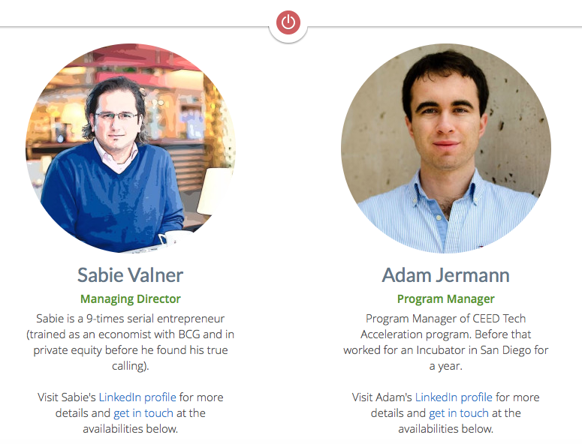
DIGITAL FACTORY
Digitalfactory.vc

Slide 7
Useful links
Digital Factory
Honlap: www.digitalfactory.vc
Facebook: https://www.facebook.com/DigitalFactoryIncubator
FIWARE
FI-Lab: http://lab.fi-ware.org
FI-Edu: http://edu.fi-ware.org/
FIWARE Wiki: https://forge.fi-ware.org/plugins/mediawiki/wiki/fiware/index.php/Main_Page
Enabler Library: http://catalogue.fi-ware.org/

